Slide 1

Rock-Paper-Scissors Image Classification Using Deep Learning
By Roy Kurien

Slide 2
Objective & Learning Goals
Objective:
Implement and train a CNN to classify Rock-Paper-Scissors hand gestures.
Learning Goals:
Apply deep learning for real-world image classification.
Learn PyTorch and model evaluation workflows.
Deploy with Gradio for interactive use.

Slide 3
Dataset Overview
Dataset: Rock–Paper–Scissors (Kaggle)
Total Images: 2,892 color images (CGI-generated)
Classes: Rock, Paper, Scissors
Image Size: 300×300 pixels, 24-bit color
Background: All hands posed on a white background
Structure:
Folders: train/, validation/, test/
Balanced number of images per class
License: Creative Commons BY 2.0 (free for use with attribution)
Source: Kaggle Dataset

Slide 4
Data Preprocessing
Resized all images to 150x150 pixels
Normalized pixel values to [0, 1]
Used PyTorch ImageFolder and DataLoader

Slide 5
CNN Architecture
2 Convolutional Layers (32 → 64 filters)
MaxPooling + ReLU
Fully connected layer (128 units)
Output layer (3 classes)
Activation: ReLU & CrossEntropyLoss

Slide 6
Model Training
Optimizer: Adam
Loss Function: CrossEntropy
Epochs: 10
Device: CUDA if available
Training monitored by accuracy and loss per epoch

Slide 7
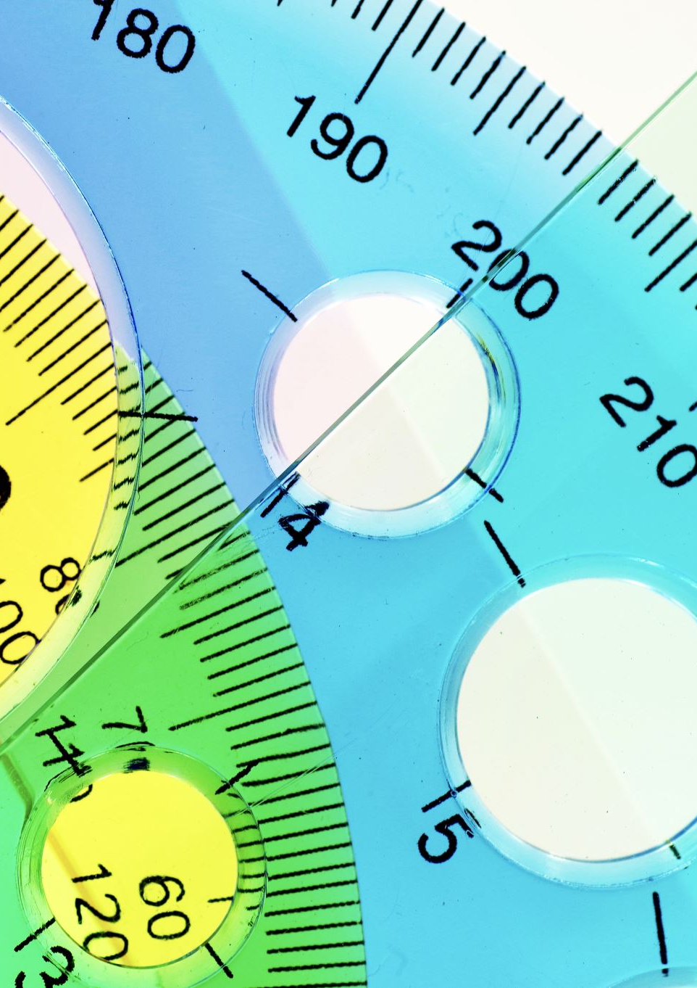
Hyperparameter Tuning
Tried learning rates: 0.001, 0.0005, 0.0001
Best accuracy at lr = 0.001
Helped faster convergence & better performance

Slide 8
Results
Validation Accuracy: 81.82%
Test Accuracy: 75.81%
Good generalization on unseen data
Some confusion between similar gestures

Slide 9

Deployment with Gradio
Built a GUI using Gradio
Upload an image → Predicts Rock, Paper, or Scissors
Makes model accessible and interactive for users

Slide 10
Challenges & Lessons
Challenges:
Ambiguous gestures affected accuracy
Learning rate tuning required multiple trials
Lessons Learned:
End-to-end PyTorch training
Importance of hyperparameters
Deploying ML models with Gradio

Slide 11
Conclusion & Future Work
Successfully built and deployed CNN model
Achieved strong performance with custom architecture
Future Plans:
Add data augmentation
Try pre-trained models (transfer learning)
Improve UI/UX in deployment

Slide 12

THANK YOU

